Slide 1
Coaxial Cables & Connectors
Nicolas M1HOG & Bryan G8DKK

Slide 2
Slide Topics
Coaxial Cables
Cable Types
Coaxial Connectors
Connector Types
Fitting connectors to cable
Tools required
Testing
URLs

Slide 3
Choice of Cable or Connector
Choose Cable or Connector first?
My opinion is choose the cable first because:
Need to know how it will be used
Main Uses:
Antenna feeder
Patch Lead
?

Slide 4
Coaxial Cables
RG (Radio Guide) types
RG58
RG213 (formerly RG8)
Lots of Others
Westflex, Ecoflex, M&P, LMR
UR (Uniradio) types
UR67

Slide 5
Properties of Coax Cables
Loss per metre
Resistive loss
Dielectric loss
Maximum Frequency of operation
Mostly determined by diameter
And to a lesser extent Dielectric
Maximum Power rating

Slide 6
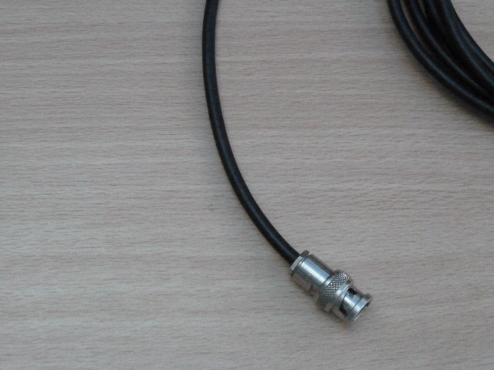
RG58 (/U, /BU, /CU)

Slide 7
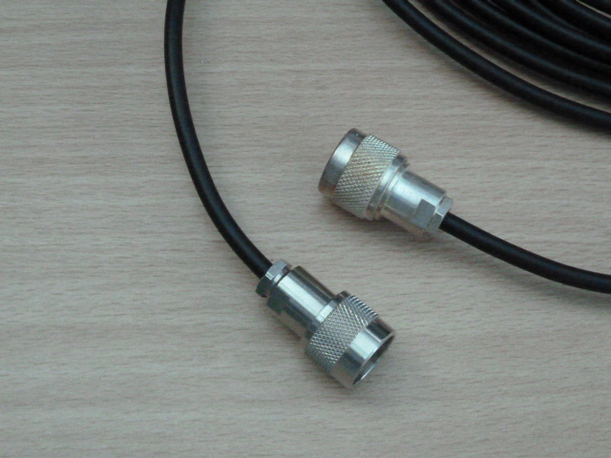
URM43

Slide 8
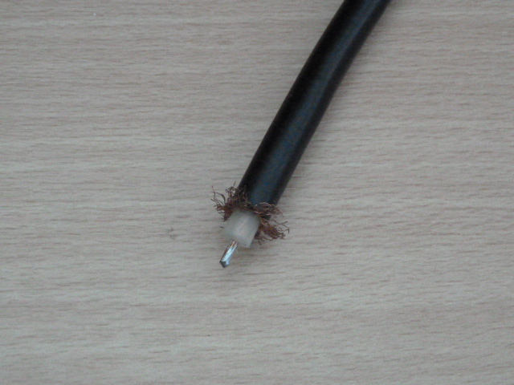
RG213 (RG8, UR67)

Slide 9
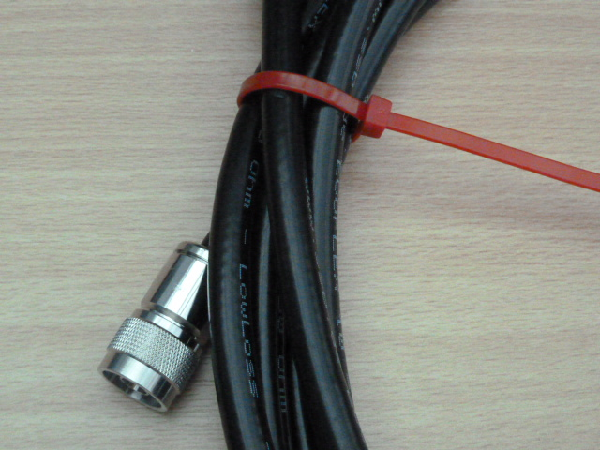
Ecoflex10

Slide 10
Coax Connectors
Most Common Types (used by radio amateurs)
PL259 + SO239
BNC
Type N
(SMA)
All originally designed in USA in 1940s
All with PTFE (Teflon) dielectric

Slide 11
Crimp or Solder?
Solder for preference and definitely for the centre pin
Most connectors are compression fitting for the outer conductor
The exception is PL259 where it is a recent option
Crimp the outer ONLY if you have the correct crimping tool
Do not buy cheap crimping tools

Slide 12
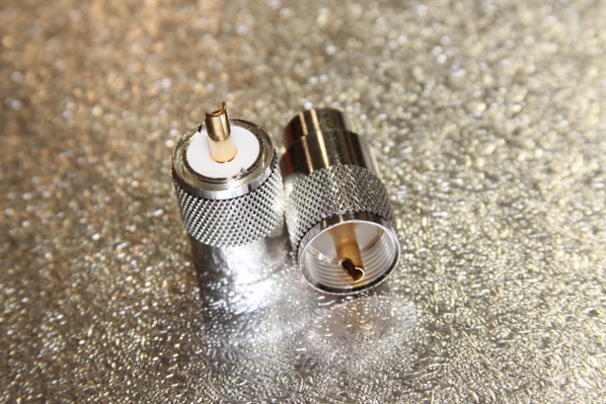
PL259 Connector

Slide 13
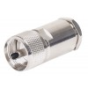
PL259 Compression Plug

Slide 14
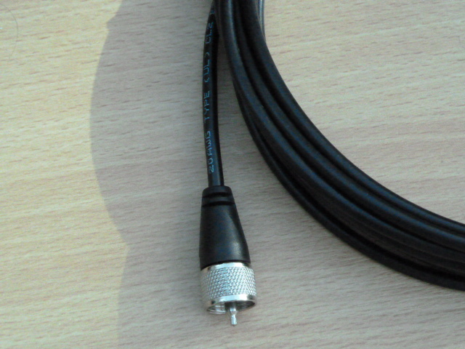
PL259 on RG58

Slide 15
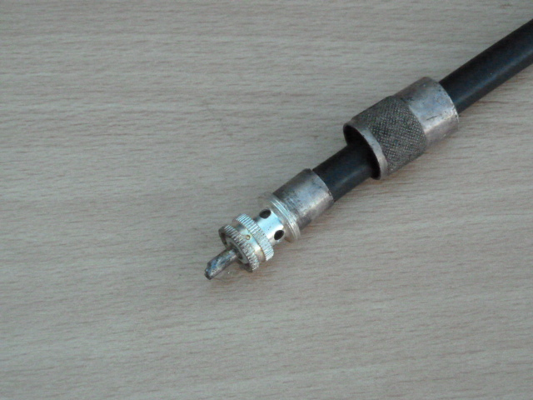
PL259 on RG213

Slide 16
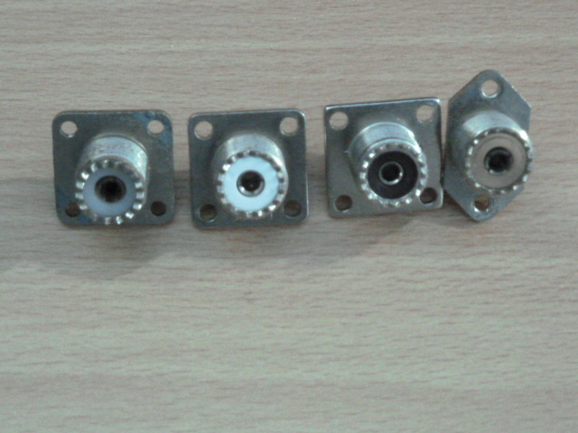
SO239 Connector

Slide 17
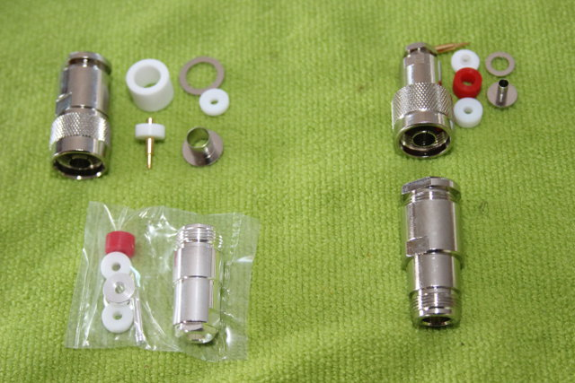
Type N Connector

Slide 18
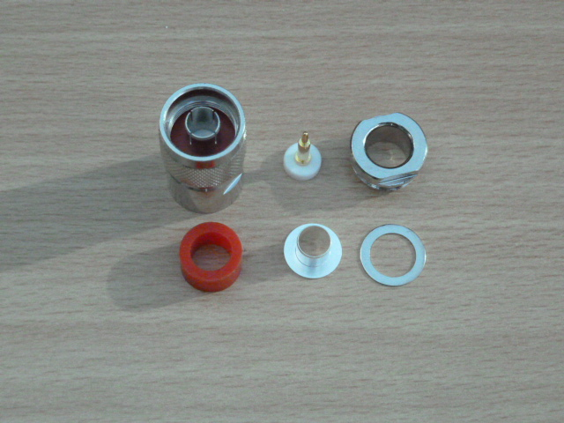
Chinese N type (male)

Slide 19
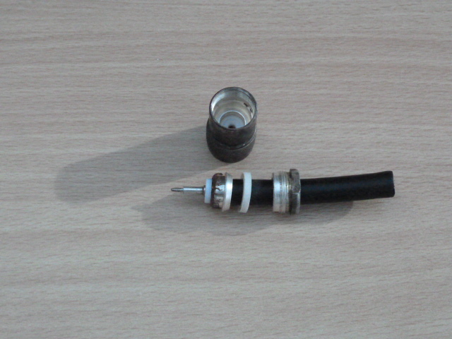
N(m) on RG213 (Cone Mount)

Slide 20
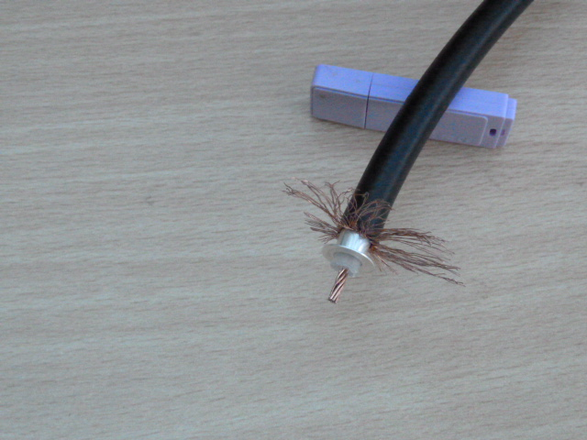
Preparing RG213

Slide 21
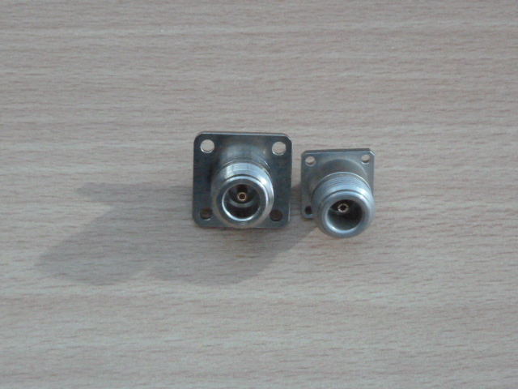
Type N Chassis Mount (f)

Slide 22
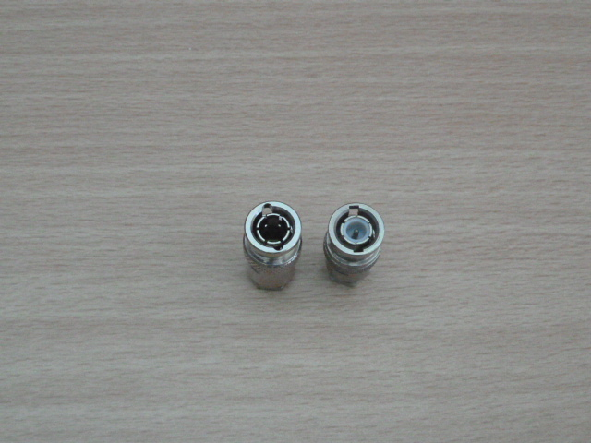
BNC Connector

Slide 23
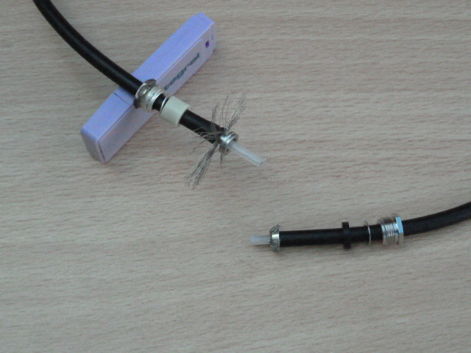
BNC on RG58

Slide 24
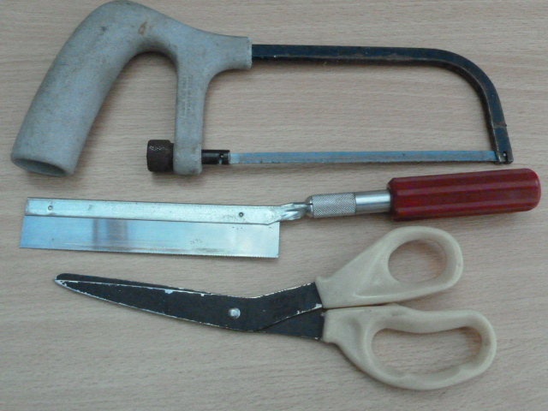
Tools

Slide 25
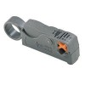
Cutting & Stripping Tools
Coax stripping tool for inner & outer.
Not tried but probably not worth the £10 price tag

Slide 26
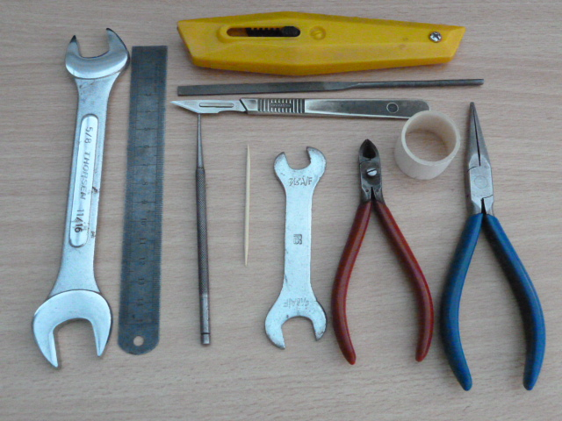
More Tools

Slide 27
Testing the Connection
Start with a simple DC test
Test inner to inner, outer to outer then inner to outer
RF Test with both ends terminated in a connector
Fit a 50Ω load to one end
RF test with an antenna analyser

Slide 28
URLs
www.whwestlake.co.uk (RG cables & connectors, Westflex)
www.thedxshop.com (Ecoflex cables & connectors, RG213)
www.hamradio.co.uk (Messi & Paoloni cables & connectors)
Most of the dealers offer RG58 & RG213 cables but beware of cheap versions, particularly RG213 that measures <10.3mm diameter

