Slide 1
The Hardware of Software Defined Radios
From Softrock to IC-7300
Bryan, G8DKK

Slide 2
Topics
Acronyms
Baseband definition
The DC Receiver
Some other Definitions
Software Defined Receivers (SDRs)
Types of SDR
Tx/Rx SDRs – Future ideas
Some useful URLs

Slide 3
Acronyms & Buzz Words
Acronyms – abbreviations
ADC or A/D: Analogue to Digital Converter
DAC or D/A: Digital to Analogue Converter
DSP: Digital Signal Processor
FPGA: Field Programmable Gate Array
CODEC: Code/Decode
QSD: Quadrature Sampling Detector
I/Q: In-Phase / Quadrature Phase
DC Rx: Direct Conversion receiver
Baseband: next slide

Slide 4
Baseband – what is it?
A section of continuous electromagnetic spectrum starting at approx. 0Hz and extending to a frequency defined by the user
The Baseband bandwidth is therefore determined by the maximum frequency
0 1kHz 10kHz 100kHz 1MHz 10MHz 100MHz 1GHz

Slide 5
The Direct Conversion Receiver
Low Noise Amplifier
Bandpass Filter
Mixer
Low Pass Filter
Output Amplifier
Local Osc
VFO

Slide 6
Bandwidth
The difference in frequency between the highest and lowest points in a device or circuit
A superhet Rx would have -3dB IF Bandwidths of:
A few tens of Hz (500Hz) for CW
A little less than 3kHz for SSB
12kHz to 13kHz for FM
A SDR has additional limits such as:
ADC sampling rate and/or baseband bandwidth

Slide 7
Analogue to Digital Converter
As the name suggests this device has an analogue input amplifier and a digital output.
The digital output can be in either parallel or series formats
A sampling clock is needed to generate the output.
The clock runs at least twice the maximum frequency of the input

Slide 8
Software Defined Radios
The 3 most common types:
Direct Conversion SDR
Superheterodyne (superhet) SDR
Direct Sampling SDR
The superhet with SDR is a hybrid of analogue and digital technology
Some SDRs use both DC & Direct Sampling

Slide 9
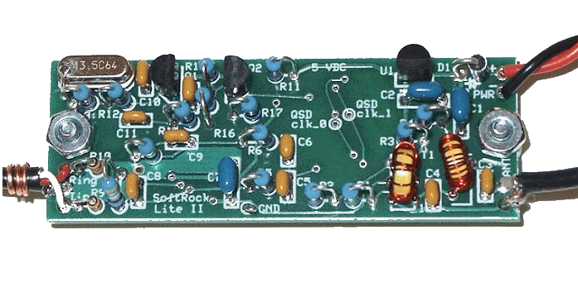
Softrock Lite II SDR

Slide 10
Softrock Block Diagram
÷2
÷2
Crystal Oscillator
Low Noise Amplifier
I
Bandpass Filter
Signal Splitter
To PC
Low Noise Amplifier
Q
Quadrature Sampling Detector

Slide 11
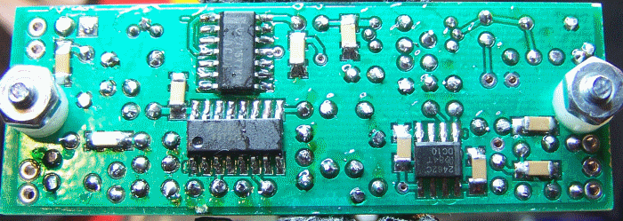
Softrock Board - Underside

Slide 12
Softrock, Processing Output
Processing of the I/Q signals takes place in the CODEC in the PC sound card controlled by a software program. Bandwidths of 48kHz or 96kHz are usual
This includes selection of mode, demodulation of the signal and conversion to an audio output to the PC speakers and/or headphone output
More complex SDRs will digitise the I/Q outputs via an on-board CODEC and convert to a digital bit stream to be sent over a USB connection

Slide 13
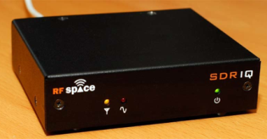
DC SDR - RFSpace SDRIQ
100kHz – 30MHz Rx, 192kHz max SDR bandwidth over USB

Slide 14
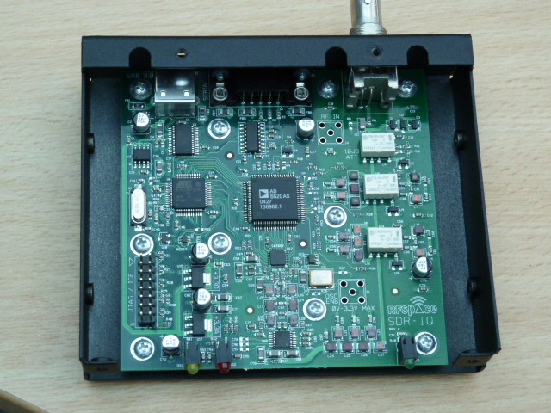
SDR-IQ Internal

Slide 15
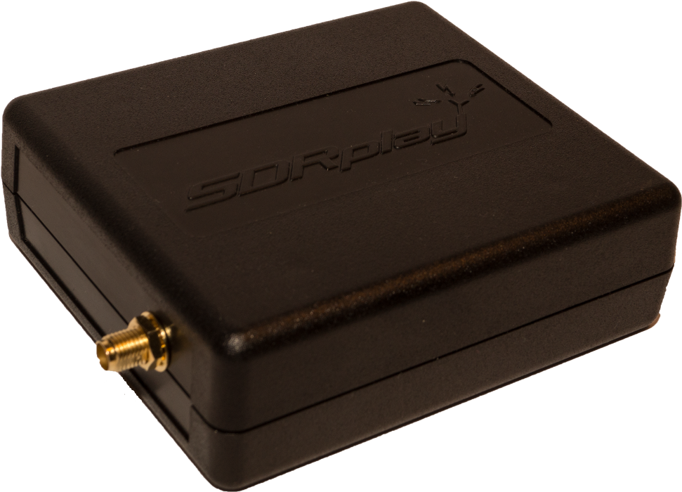
DC SDR – SDRPlay RSP-1
10kHz – 2GHz Rx, 8MHz SDR bandwidth over USB

Slide 16
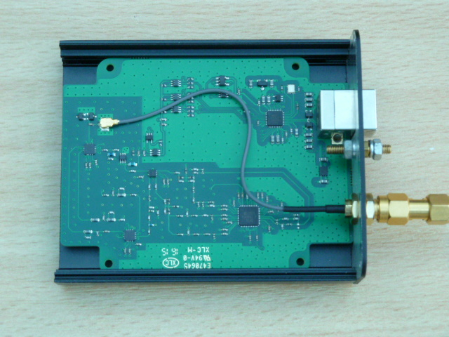
SDR Play RSP-1 Internal

Slide 17
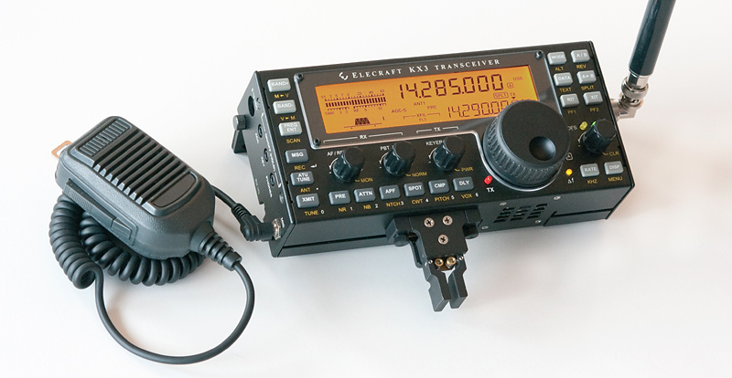
Elecraft KX3 – DC SDR

Slide 18
Superhet SDRs
These are probably the most common at the moment as most of the manufacturers removed the analogue demodulator and early audio stages from existing transceivers.
Replaced by a final low frequency IF conversion followed by a SDR demodulator and modulator

Slide 19
Superhet SDRs
Bandpass Filter
Mixer
IF Amplifier
Mixer
SDR IF & Audio
Local Osc VFO
Fixed LO
Conventional front end, SDR final IF with demod to AF output

Slide 20
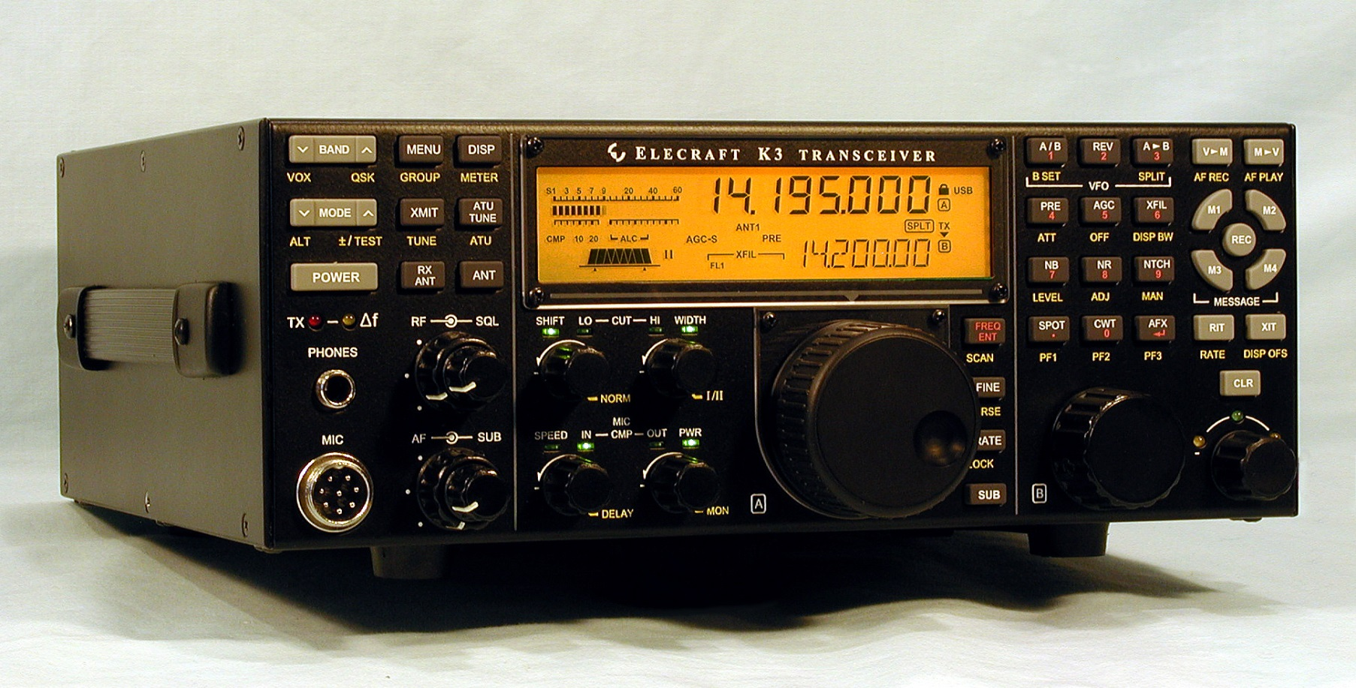
Elecraft K3/K3s SDR Final IF

Slide 21
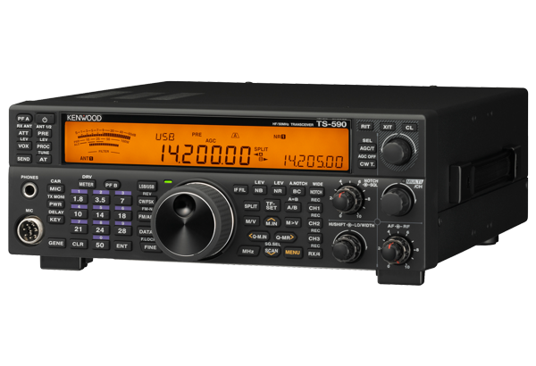
Kenwood TS590SG SDR Final IF

Slide 22
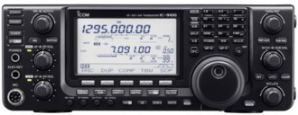
Icom IC-9100 SDR Final IF

Slide 23
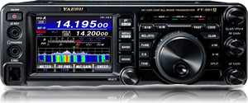
Yaesu FT-991A SDR Final IF

Slide 24
Direct Sampling SDRs
FPGA
Bandpass Filter
ADC
USB?
ADC Clock
μP

Slide 25
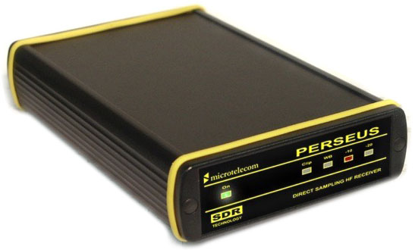
Perseus SDR Rx
10kHz - 30MHz, 80Msamples/sec ADC, 1.6MHz Baseband B/W

Slide 26
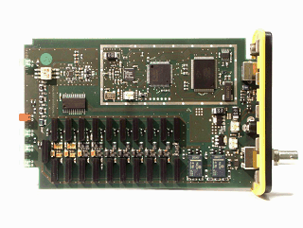
Perseus – Internal

Slide 27
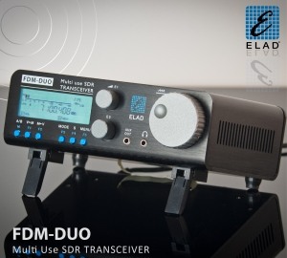
Elad FDM Duo

Slide 28
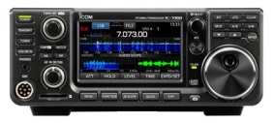
Icom IC-7300

Slide 29
Tx/Rx SDRs – The Future
Although most of the manufacturers are now integrating SDR into their products where does this leave the amateur community with regard to experimentation?
There are some building blocks available at reasonable prices

Slide 30
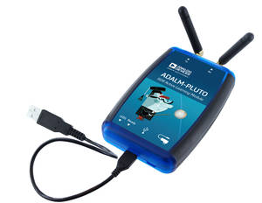
Analog Devices Pluto SDR Tx/Rx
325MHz – 3800MHz Rx/Tx, at up to 61.44Msps

Slide 31
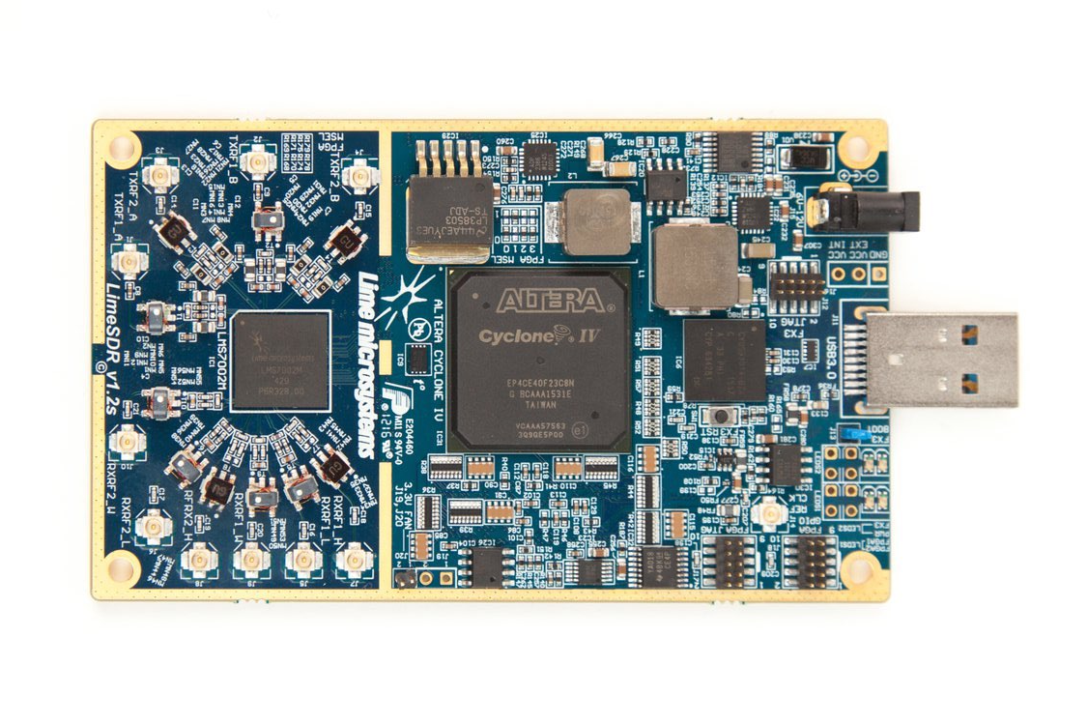
Lime SDR Transceiver

Slide 32
Last Slide
That’s all folks
Questions

Slide 33
Useful URLs
www.wb5rvz.com/sdr
www.fivedash.com (KB9YIG)
www.rfspace.com
www.sdrplay.com
www.sdr-kits.net
www.kanga-products.co.uk

