Slide 1

Introduction to Station Master Pro Logger

Slide 2
What is Station Master Pro?
Station master Pro is a totally new approach to Amateur Radio Logging.
It’s just another logging Software......but it also has
• A scope/pan-adapter
• A web sdr
• A CW decoder (can send and receive CW)
• Can also use it to do FT8/FT4 & SSTV
• Has PSK Reporter and much more
It's desktop, mobile, and tablet friendly and called 'Station Master Cloud'. (can also log via the cloud)
A desktop Logging Program for Windows 10 & 11 called 'Station Master Pro'.

Slide 3
Settings Menu

Slide 4
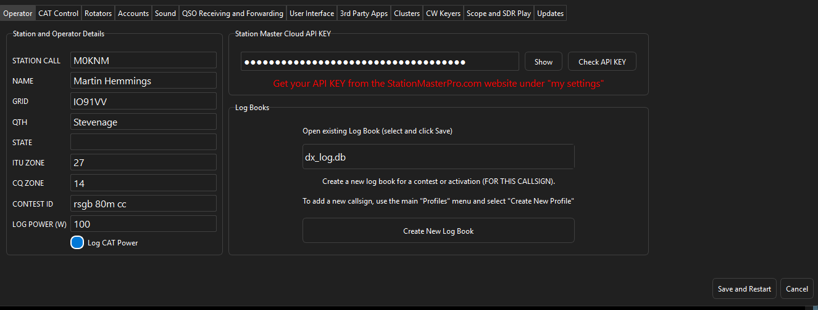
Operator
This is where you will put in the operator info such as Call sign, Name, Grid, QTH, Power e.t.c.

Slide 5
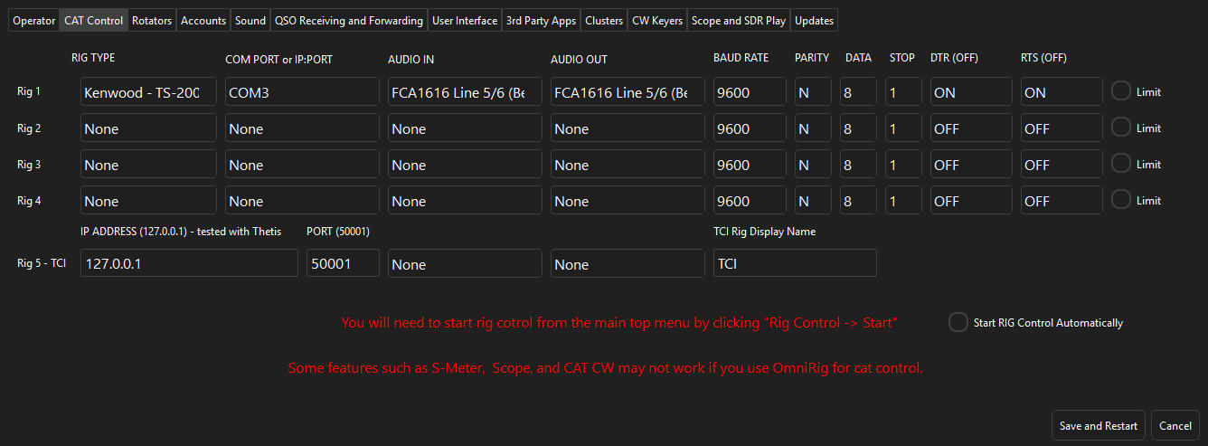
CAT Control
Here you can select your radio for CAT Control. Connect up to 5 radios in total (4 COM Ports 1 TCI). OmniRig & FLRig Support.

Slide 6
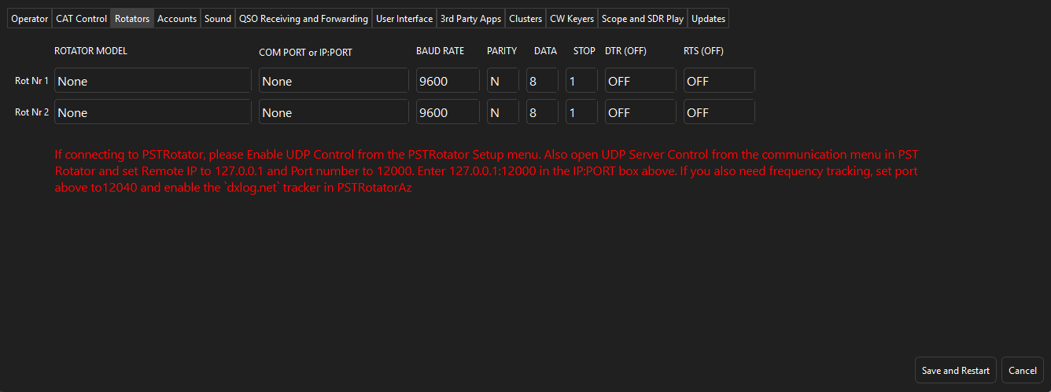
Rotator
Can connect up to 2 rotators. Has PST Rotator Support. When typing in a call sign the rotator UI will show you where to set antenna, all you need to do is push turn and it will turn rotator. It takes the short path.

Slide 7
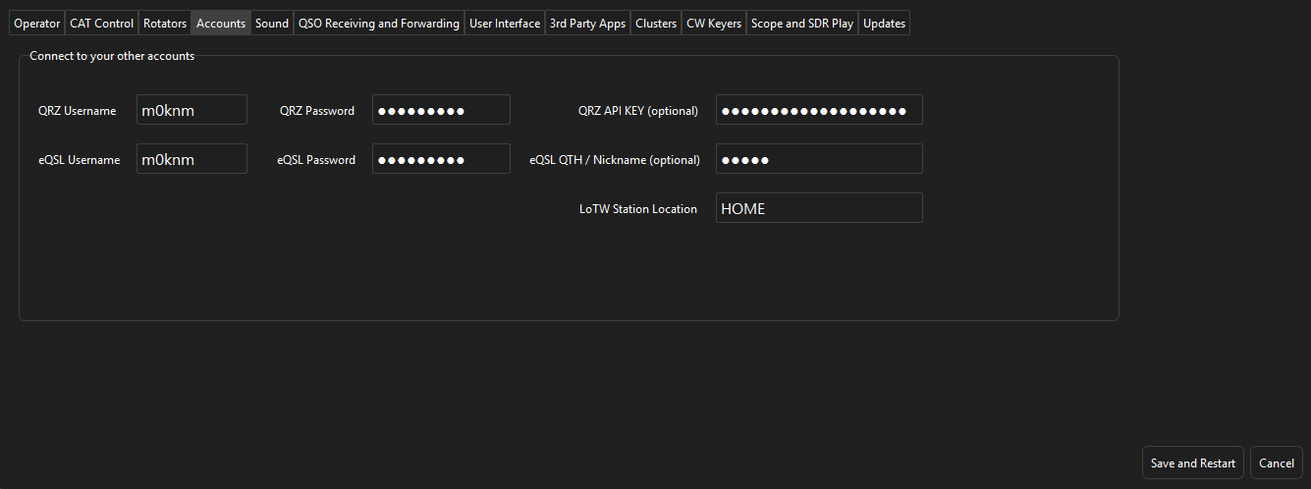
Accounts
This is where you can add your QRZ, eQSL and LOTW accounts.

Slide 8
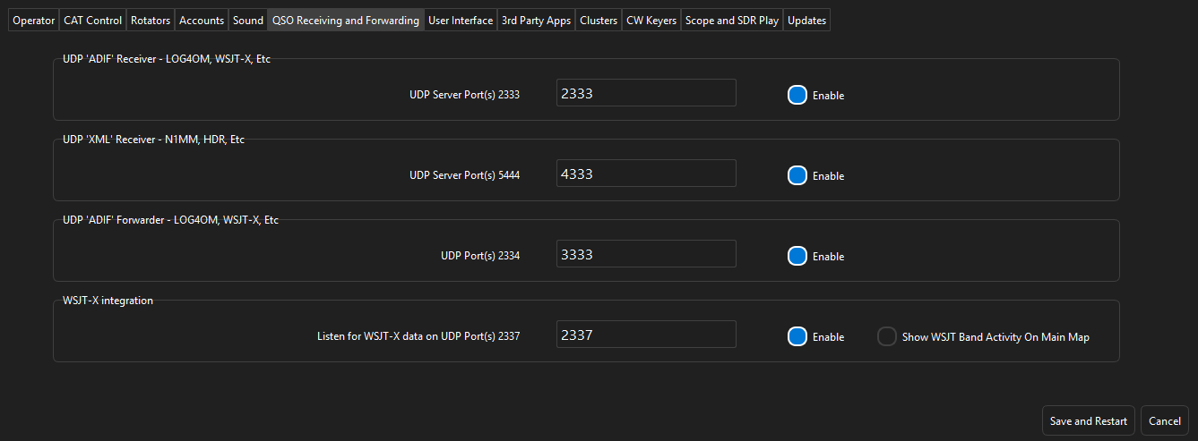
QSO Receiving And Forwarding
These are the UDP ports for sending QSO data to and from Station Master.

Slide 9
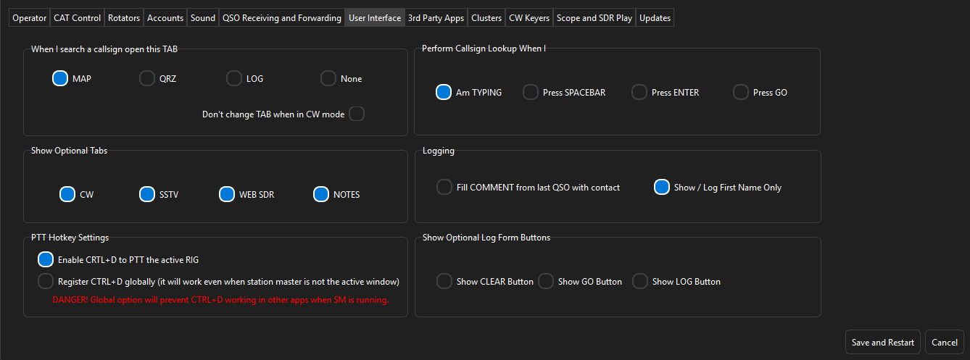
User Interface
When typing in a call sign you can have it open one of 3 tabs (Nothing/Map/QRZ or Log). You can set it to do a call sign lookup when doing one of 4 things (when typing/when pressing space/when pressing enter or by pressing GO. You have the option to show optional tabs (CW, SSTV, Web SDR & Notes). You have the option to show the CLEAR, GO & LOG buttons. There will be an option for remote when that part is ready.

Slide 10
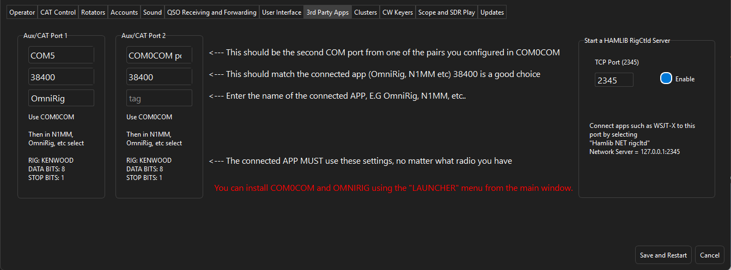
3RD Party Apps
This is how wsjt-x would talk to station master either using COM0COM and OmniRig or using Hmalib NET Rigcltd.

Slide 11
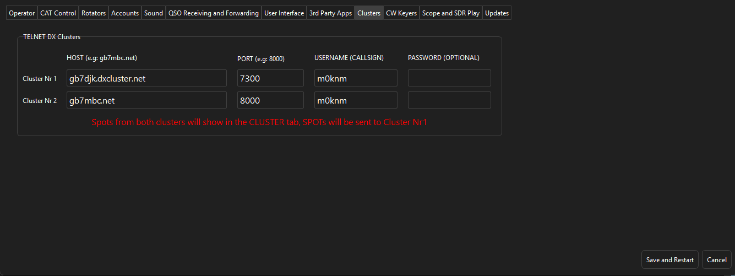
Clusters
Here is where you will put your call sign in for the cluster to work.

Slide 12
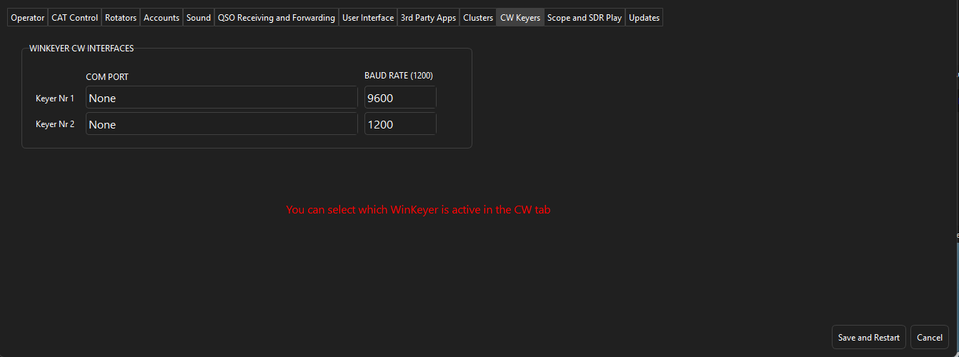
CW Key Interface
Here you can select the com port for your CW Keyer.

Slide 13
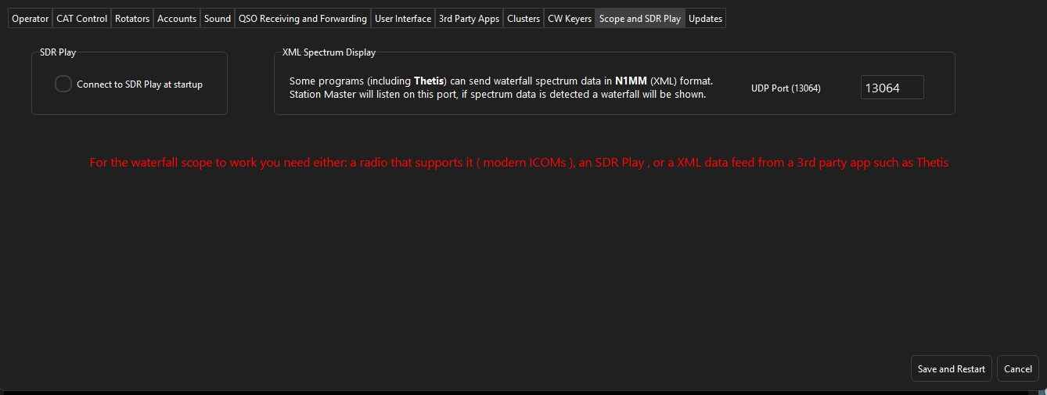
Scope and SDR Play
Here you can select if SDR Play starts at startup and select the XML Spectrum Display UDP port for programs like Thetis and N1MM.

Slide 14
Top Menus

Slide 15
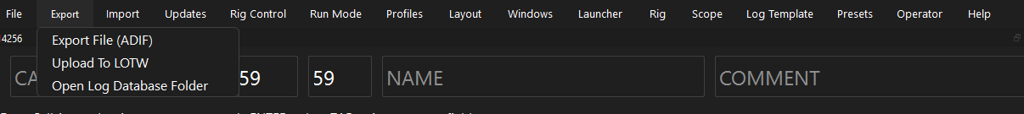
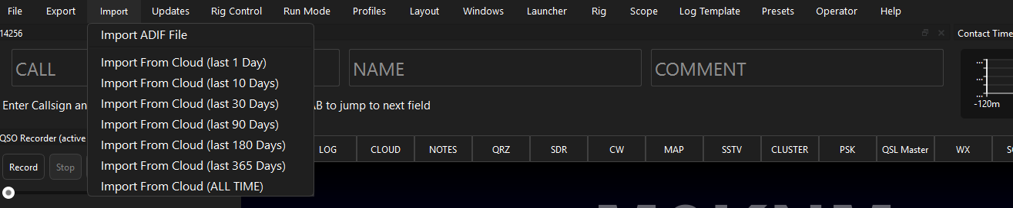
Imports/Exports
If you are coming from a different logger, you can export your log as an ADIF and then import the ADIF it will the upload to Station Master cloud. You can Upload to LOTW. Once you have uploaded your log and if you ever needed to reinstall Station Master all you need to do is import all from cloud and you then have your log back. Cloud logs are backed up at server end 3 times a day.

Slide 16
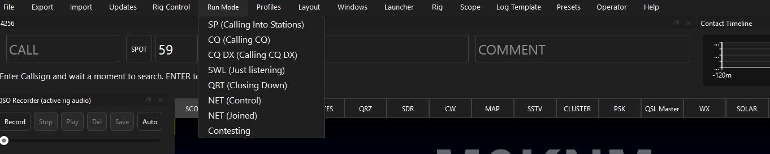
Run Mode
These are just different settings mainly for station master cloud showing on there what you are doing on the frequency you are on.

Slide 17
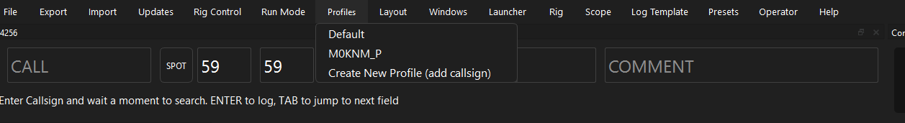
Profiles
Profiles are basically just call sign databases. You can have as many Profiles as you like. Each profile is completely separate from another.

Slide 18
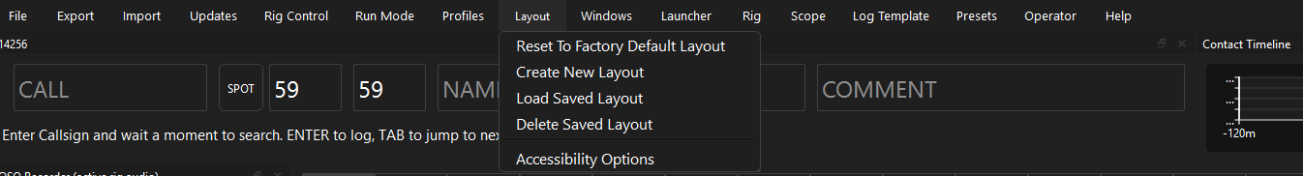
Layout
Layouts are the different position you can put the windows in. You could have as many layouts as you wish, you could have one full layout (all windows open) for normal use or even a reduced layout if you don’t like too much going on and save the layout so when you start station master it will load the layout. At any time, you can revert to default layout settings. You can pop out tabs and they can be docked and will be remembered.

Slide 19
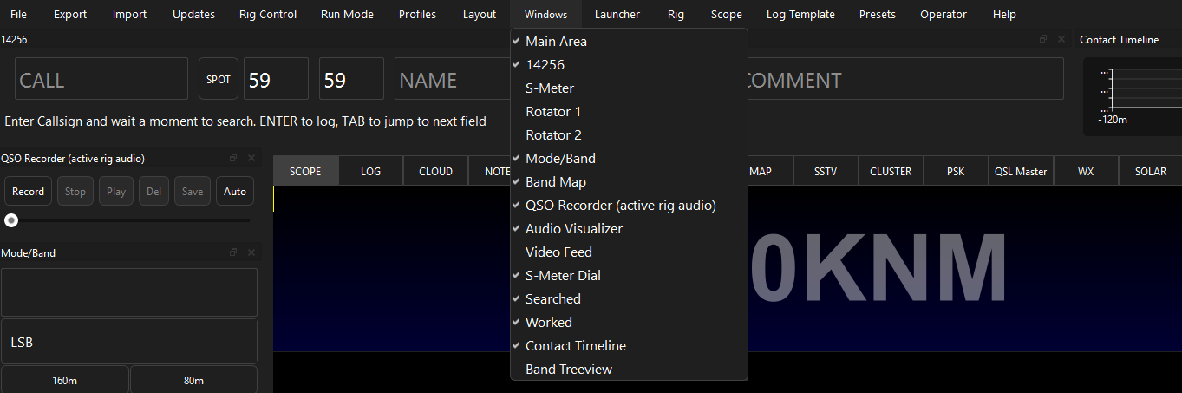
Windows
Here you can select what window you want open to display. You would choose what window you would want open then can save in the position with save layout. The windows available are: Main Aera (where the tabs are), Call Sign input, S Meter, Rotator 1 & 2, Band/Mode, Band Map, QSO Recorder (5min record time, you can save the file where ever you want & will upload the mp3 to the cloud for others to listen to), Audio Visualizer, Video Feed, S-Meter Dial, Worked & Searched Maps, Contact Timeline (how many QSO’s over 2 hours) & Band Tree (A tree view of the Cluster).

Slide 20
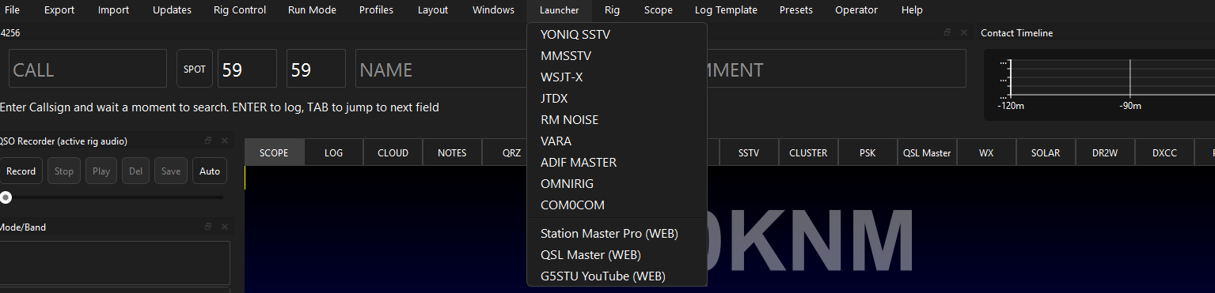
Launcher
These are programs that can be launched within Station Master much like N1MM can for digital modes. Programs such as YONIQ SSTV, MMSSTV, WSJT-X, JTDX, RM NOISE (ai Noise Reduction), ADIF MASTER, OMNIRIG & COM0COM. If for instance you click to open WSJT-X but do not have it installed it will tell you that you do not have it installed then ask if you wish to download and install.

Slide 21
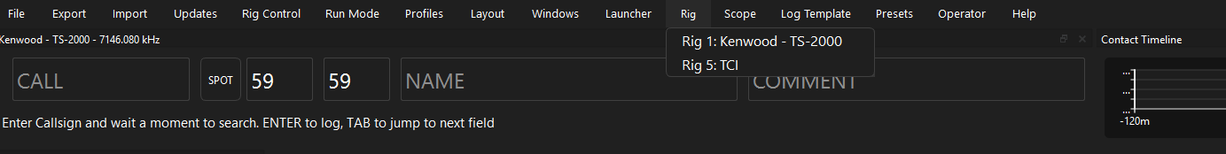
Rig
This is where you can select the radio you wish to use with Station Master. For example, if you have an IC-7300 for HF and then you have an IC-9700 for VHF/UHF you can switch between radios with a click of a button.
Station Master will remember the last radio used when restarting back up.

Slide 22
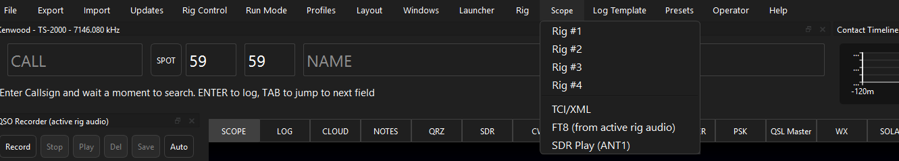
Scope
Here you can select the scopes from different radios, for older radios with no scope you would just click the FT8 scope.

Slide 23
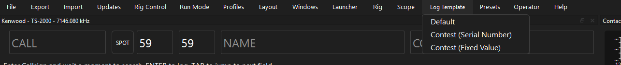
Log Template
Here there are 3 different templates Default, Contest (Serial Number) & Contest (Fixed Number).
Default is your normal log. Contest (Serial Number) is a basic contest log. You should create a new logbook when starting a contest. Then afterwards, export the contest log, switch back to the main log, then pull from cloud to add those contest logs to your main local log. Having a new log for each contest allows the DUPE highlighting and serial numbers to work correctly.

Slide 24
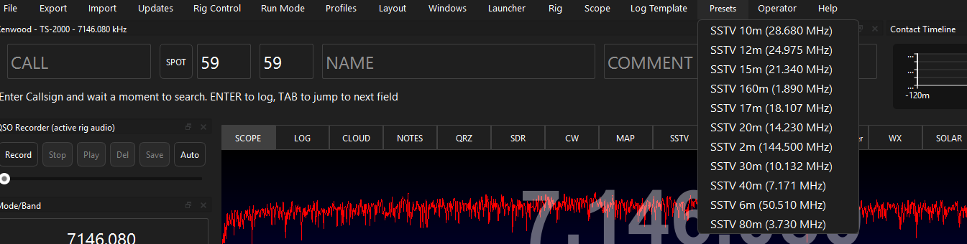
Presets
Here are some preset frequencies for SSVT from top band to 2m.

Slide 25
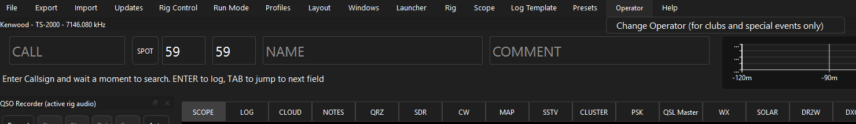
Operator
Can change the operator call sign this is used for clubs and special event stations.

Slide 26
Tabs

Slide 27
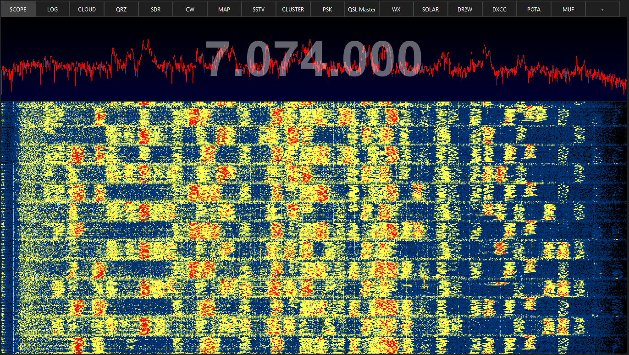
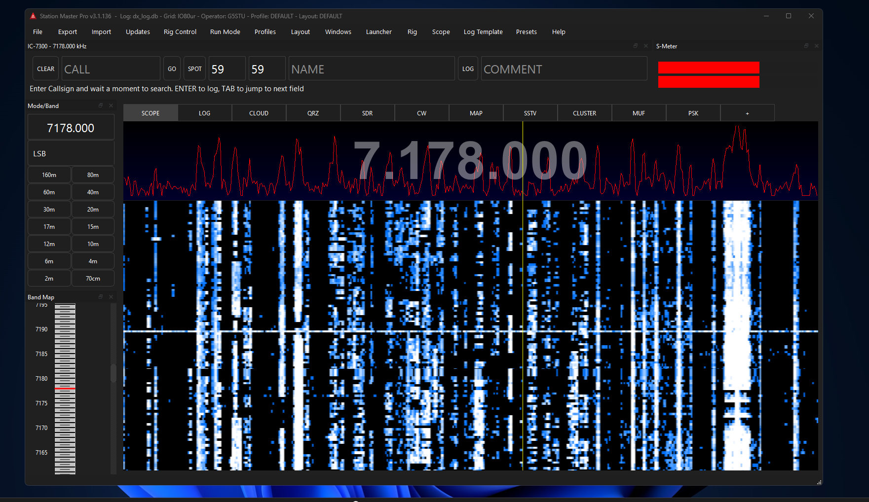
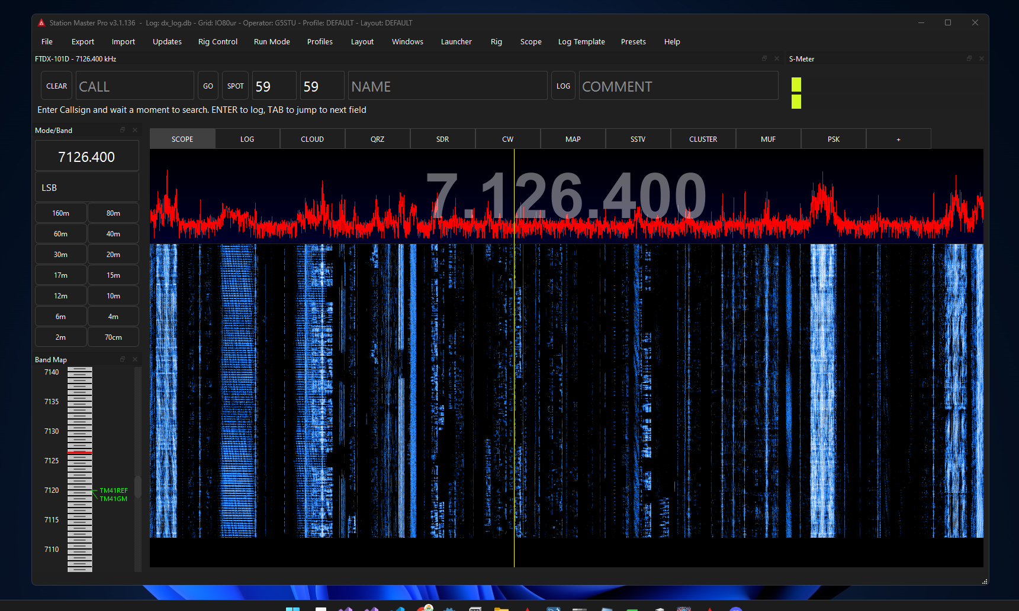
Scope
Scope from Kenwood TS-2000
Scope is taken from CAT commands.
Great for newer radios with scopes.
Not all radios will have the scope.
Better quality resolution with the SDR Play.
Scope from IC-7300
Scope from SDR Play

Slide 28
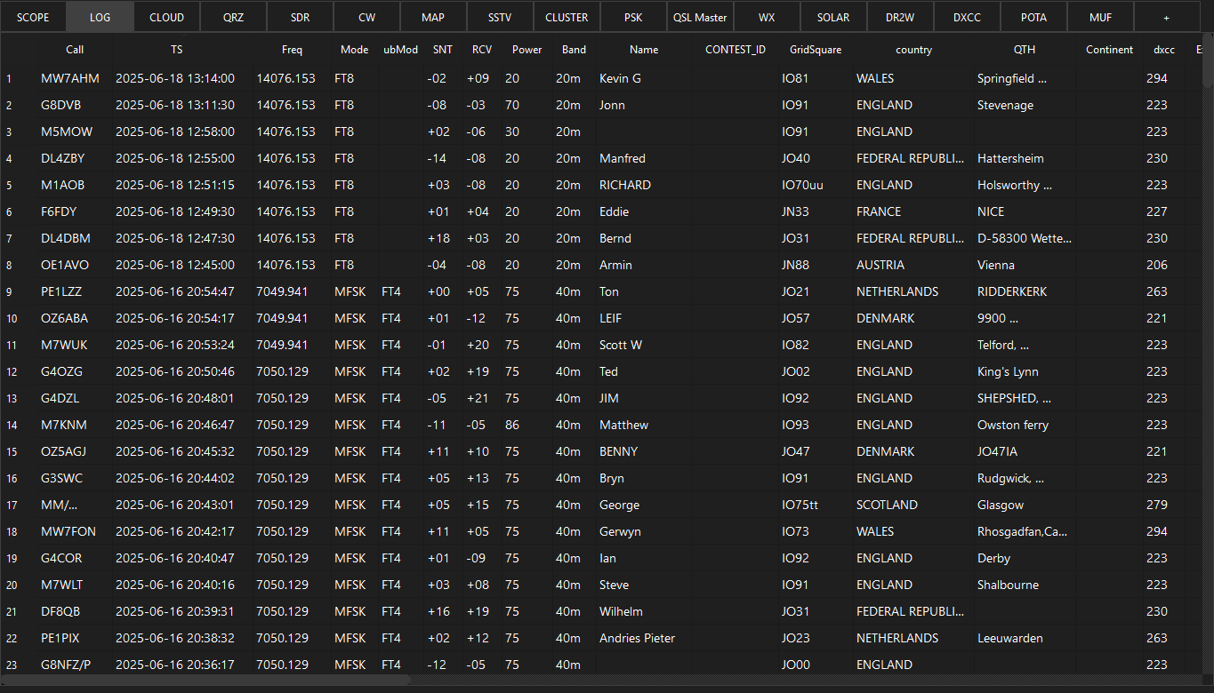
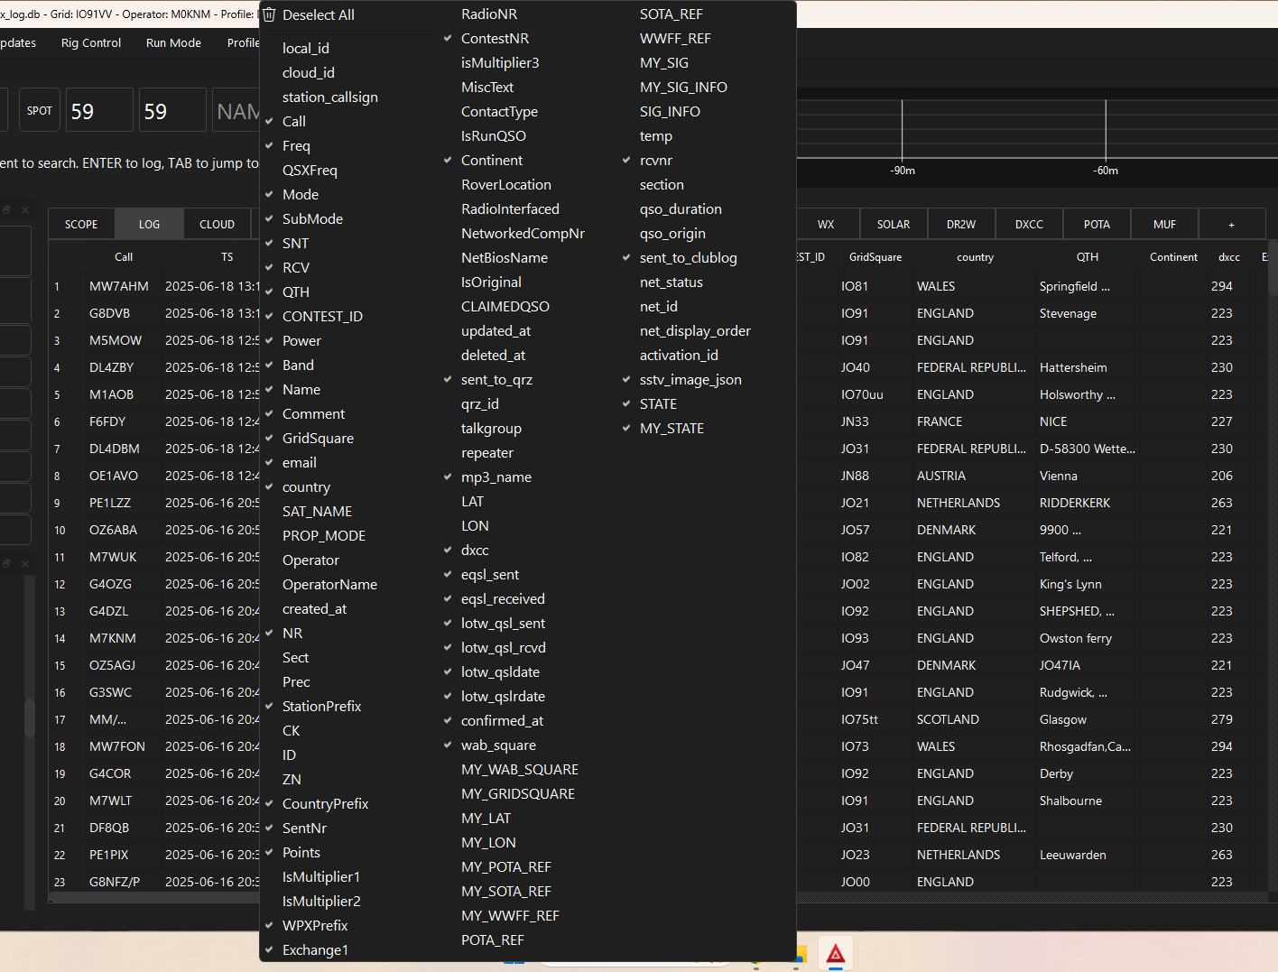
Logs
Basic logging like you see on most loggers.
Can select what info/columns’s you want.
Can select in settings what you want it to do when typing in a call sign.

Slide 29
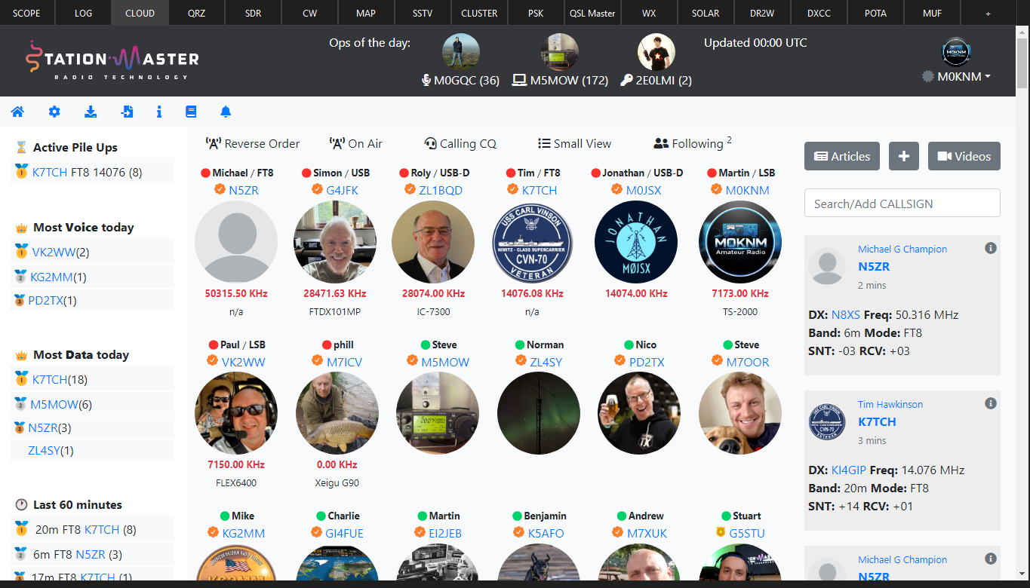
Cloud
This is the Station Master cloud.
Can see in real time when someone changes frequency.
Shows everyone that has Station Master if they on logged in and active.
Has leader board type column’s showing who has made the most contacts CW/DATA/SSB/ACTIVE PILEUP’s.

Slide 30
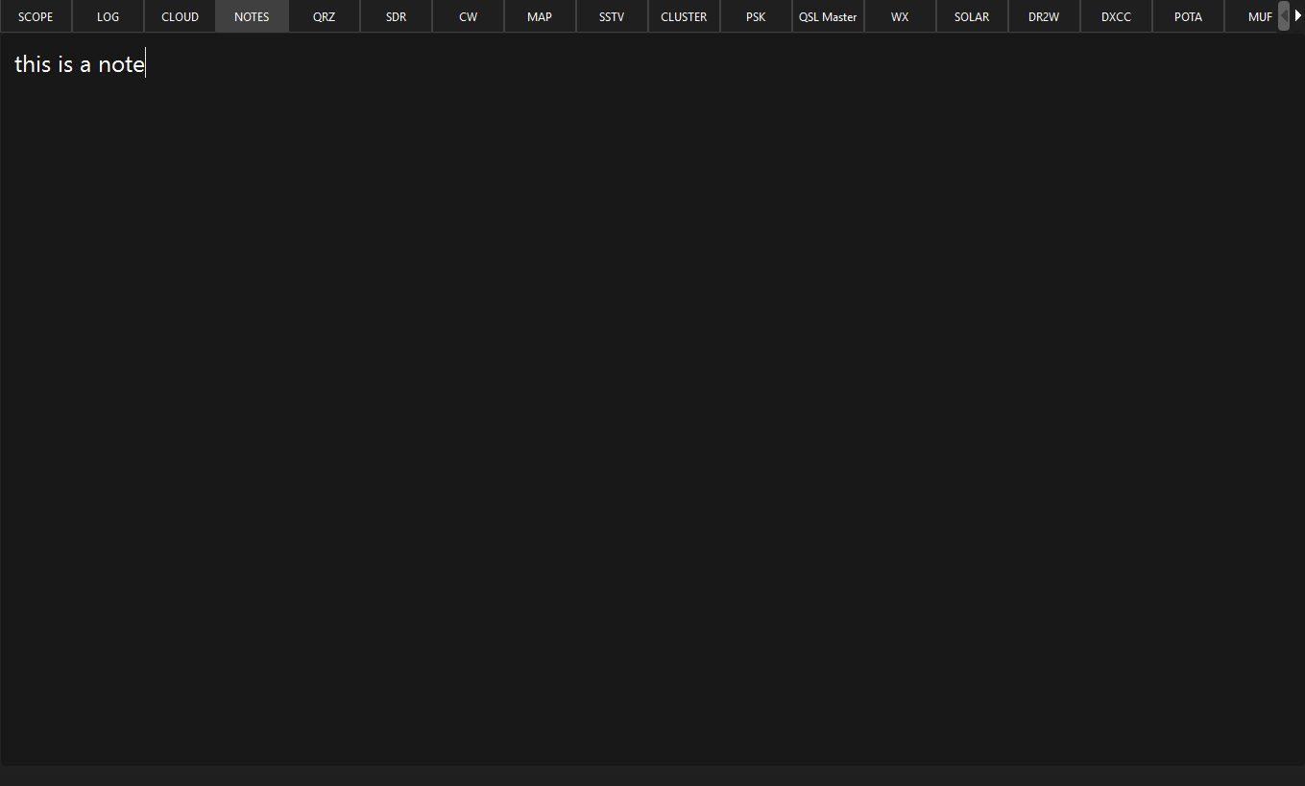
Notes
Here you can add notes when in a QSO with someone or even when in a net taking names down.
All notes auto save.

Slide 31
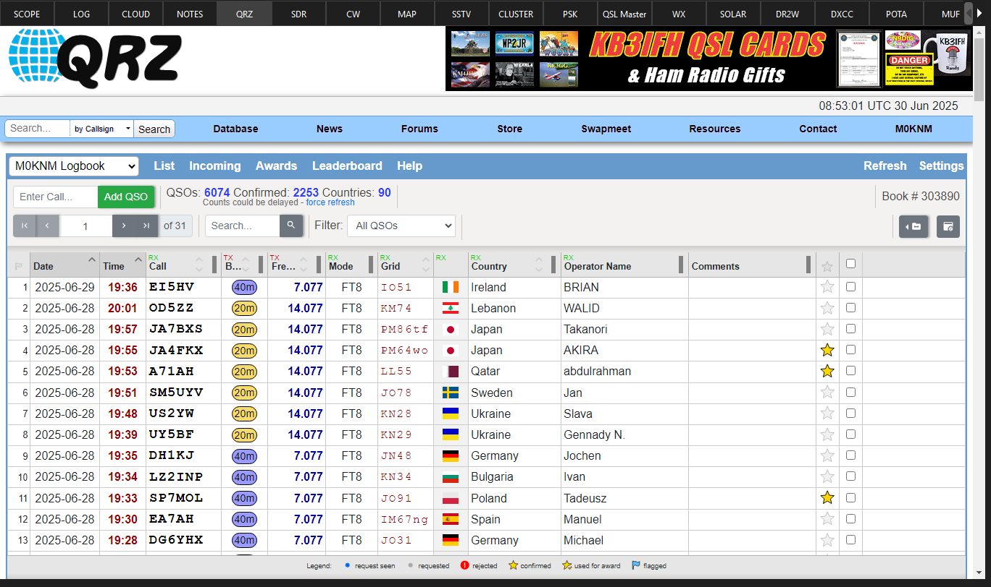
QRZ Integration
With QRZ integration when tying in a call sign it will pull up their QRZ profile.
With a QRZ subscription it will send logs to QRZ.

Slide 32
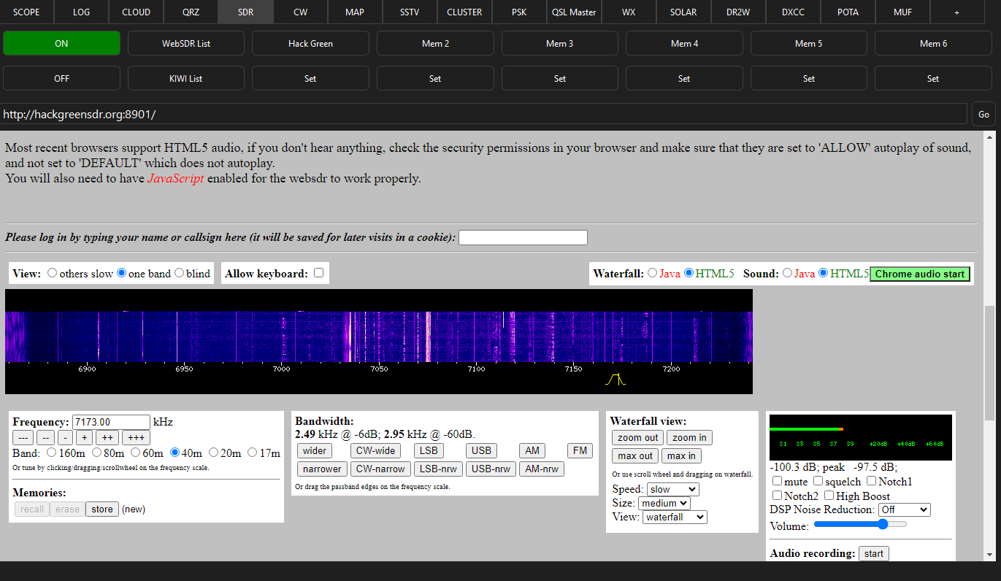
SDR
It has a web sdr and kiwi sdr list.
Can have 6 web sdr stored in memories.
When your radio is connected to station master pro the web sdr will follow VFO.

Slide 33
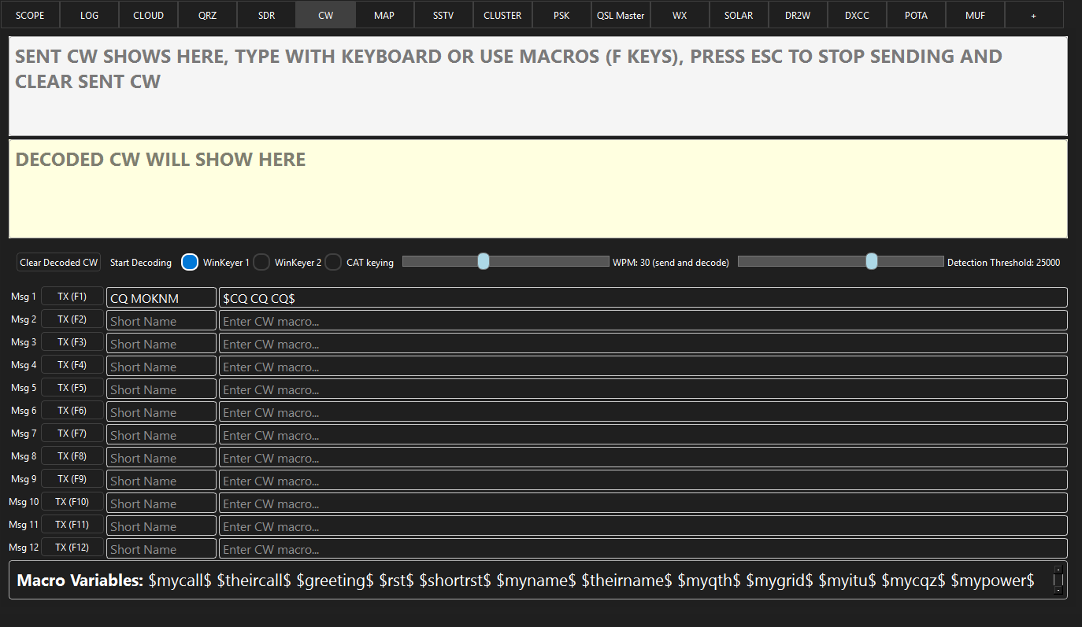
CW
Can encode and decode CW within Station Master.
Can use winkeyer or CAT Keying (tested with ic-7300).

Slide 34
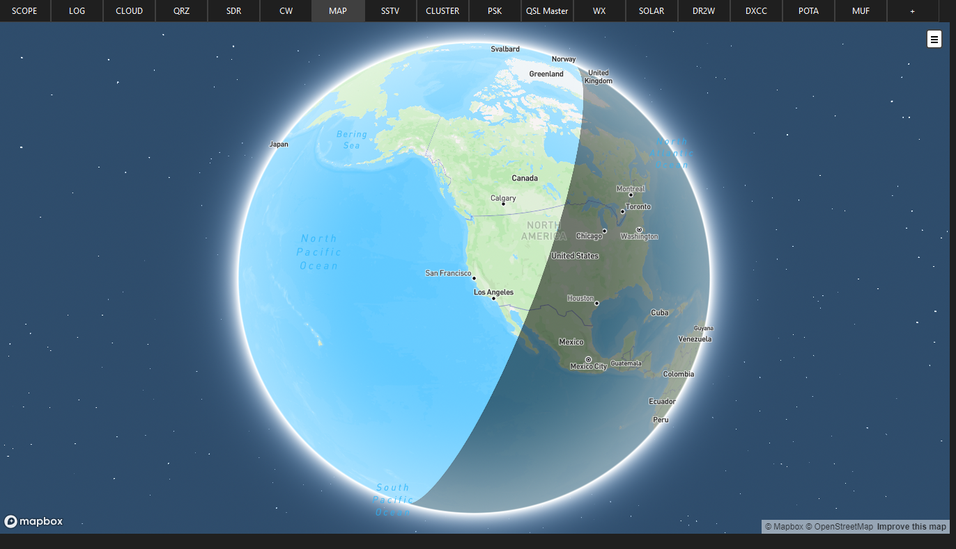
Map
Mapping features can visualise the contact.
There is 2D and 3D maps.
Night shadow.
Turn auto zoom on and off.
While doing FT8/FT4 with wsjt-x the map will show gridtracker like lines on the map to show path of contact (this is still a work in progress), this can also be turned off from the settings if you wish not to use it.

Slide 35
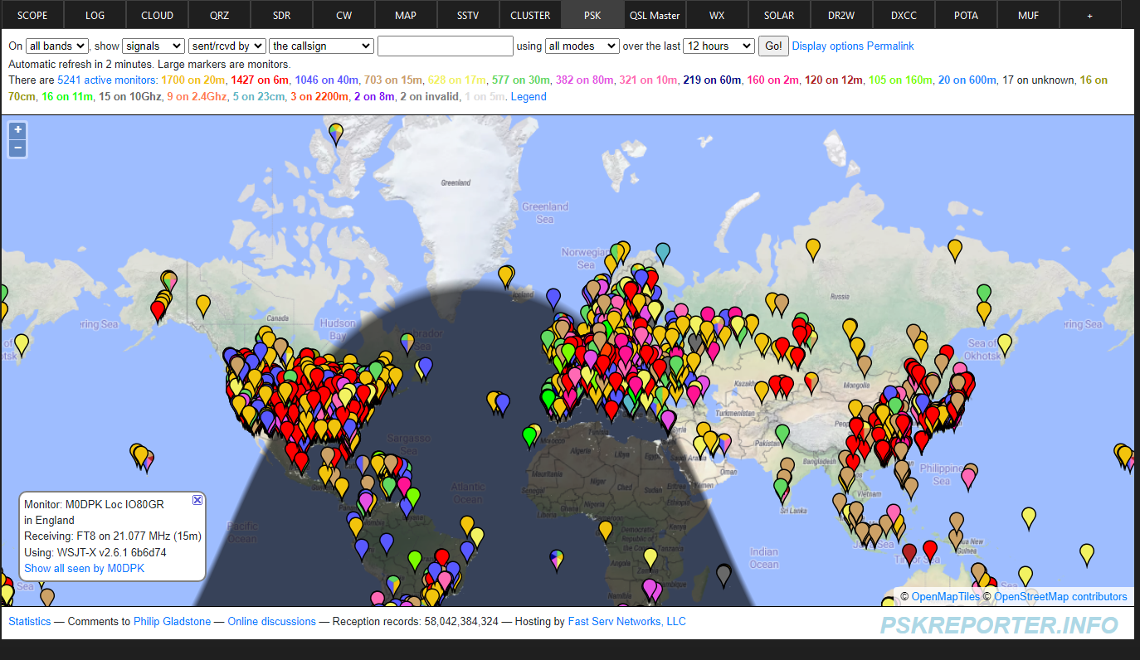
PSK Reporter
Has PSK Reporter tab for when doing FT8 modes.

Slide 36
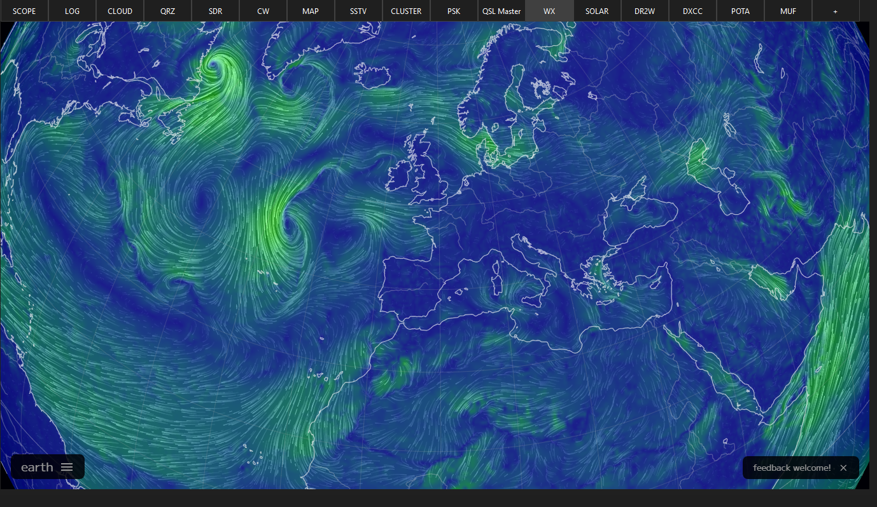
WX
Has a wind/sea weather bit.

Slide 37
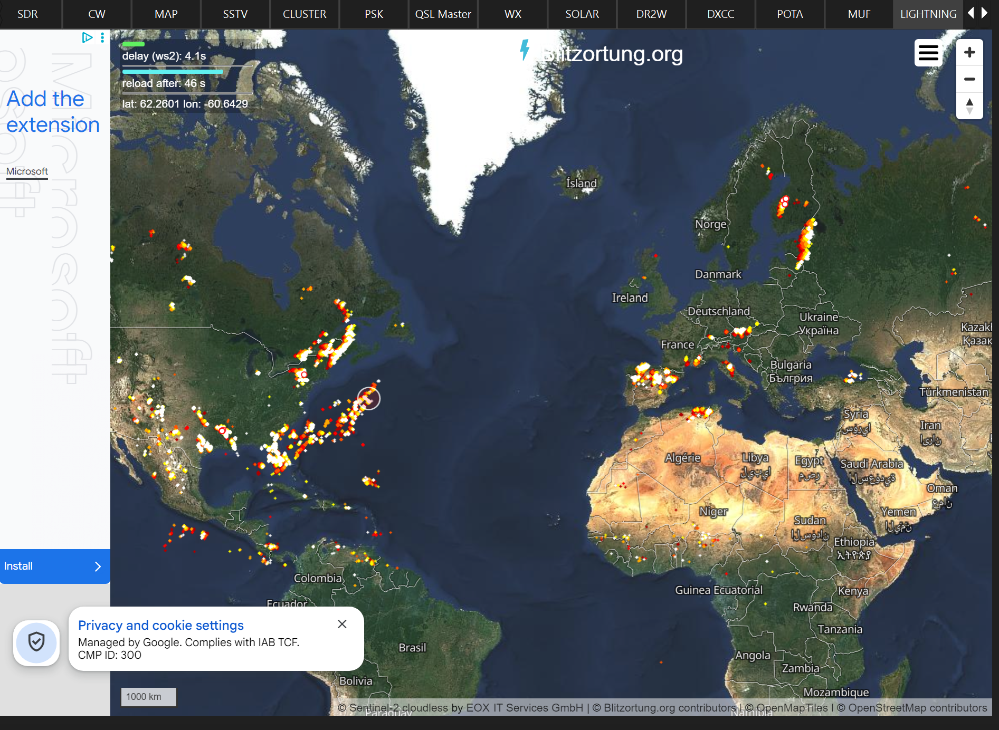
Lightning
Has a lightning map to show real time lightning across the world.

Slide 38
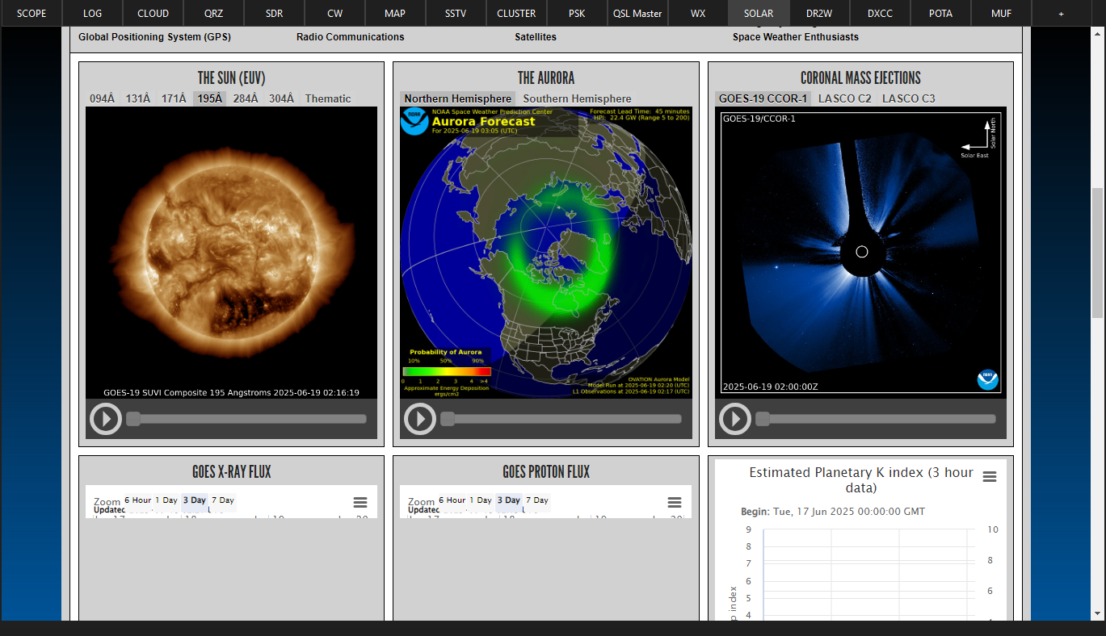
Solar
Space weather prediction.

Slide 39
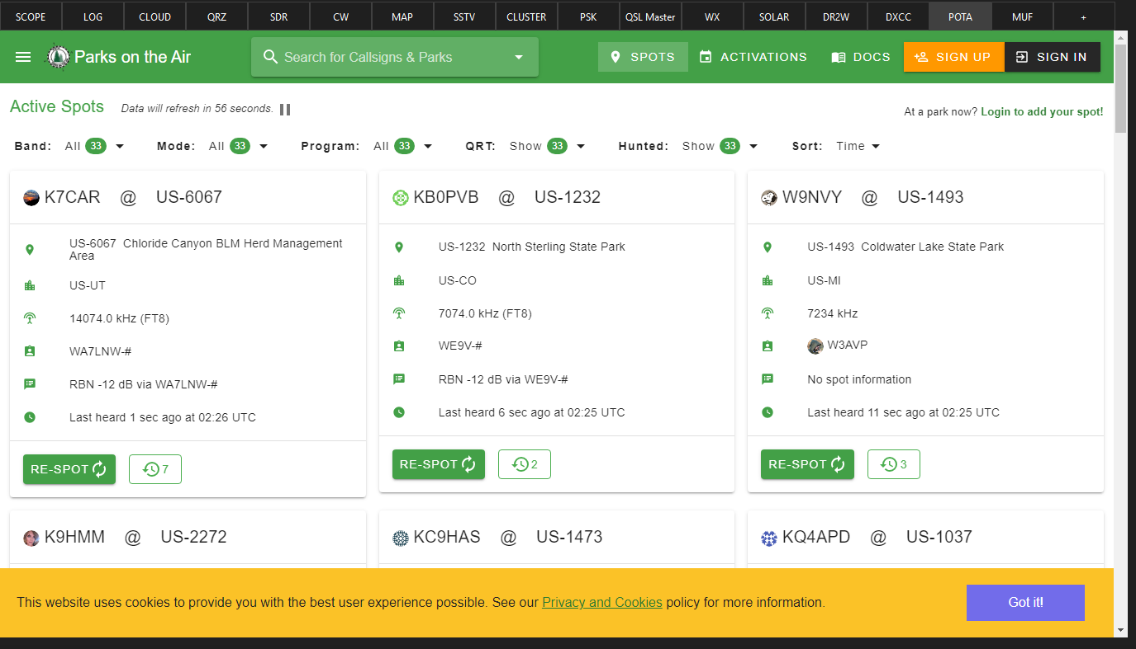
POTA
Opens the POTA web page.

Slide 40
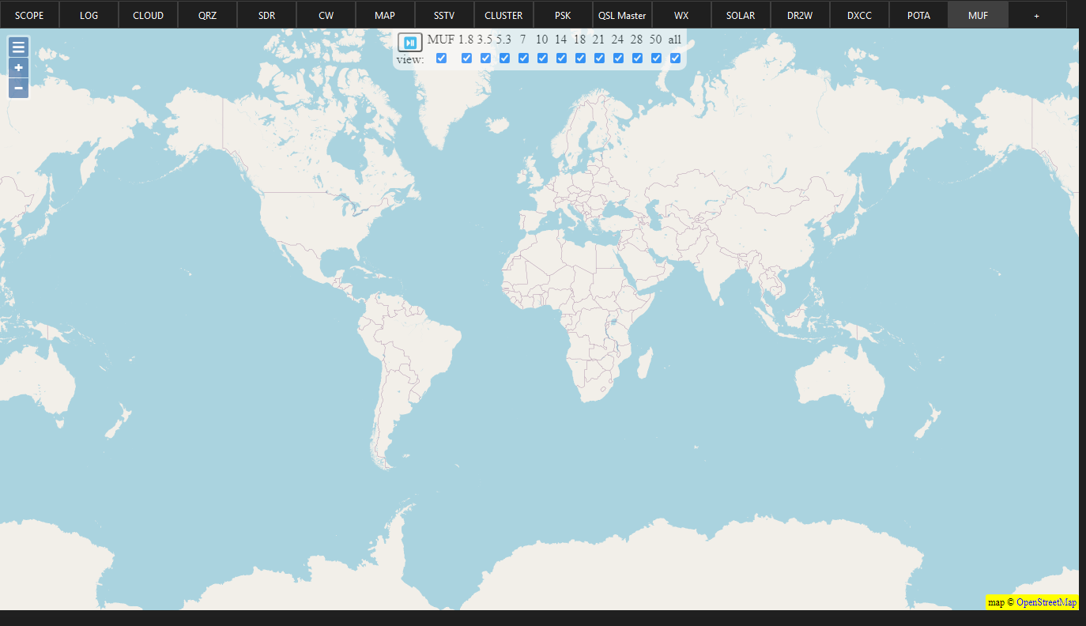
MUF
Opens the Maximum Usable Frequency page where you can see where a typical SSB/CW/DATA signal might go.
Data taken from hf.dxview.or

Slide 41
Pros & Cons

Slide 42


Pros
Only £3.33pm or £36.50 Yearly (saving 9.5%)
All in one logging software
Will be customisable
Android/IOS app (this is also being updated)
Very good and quick support https://discord.gg/WqgQKmaKeh

Slide 43


Cons
There are none! Go subscribe......only messing.
It’s Not free there is a subscription (£3.33pm or £36.50 Yearly).
Windows only program at the moment (Linux and Mac versions are in the works as we speak, V1 is windows only & V2 is windows, Linux and Mac).
No Raspberry PI support at the moment.

Slide 44
Thank You For Watching

Slide 45
Any Questions?

